Slide 1
Nutrition & Medical Managements in Metastatic Spinal Cord Compression
國泰醫院復健科
Case Discussion
Cancer
R2吳一宏, Yi-Hong Wu
Moderator:
Date: July 21st, 2026

Slide 2
Course

Slide 3

Timeline
Date | Clinical Course & Interventions
06/12 | Sent to ED due to progressive right upper back pain, bilateral lower limb weakness and numbness for 2 weeks, rendering her unable to stand or walk.
06/13 | TL-spine X-ray: T9 compression fracture.
 | Admitted for further evaluation and management.
06/15 | NCV/F-wave: compatible with sensorimotor polyneuropathy.
06/17 | Surgery performed: T7-11 laminectomy, T9 tumor excision, T7-8 and T10-11 posterior fusion with postero-lateral bone fusion, and L2 kyphoplasty.
 | Transferred to SICU post-operatively.
06/18 | Transferred to ordinary ward.

Slide 4
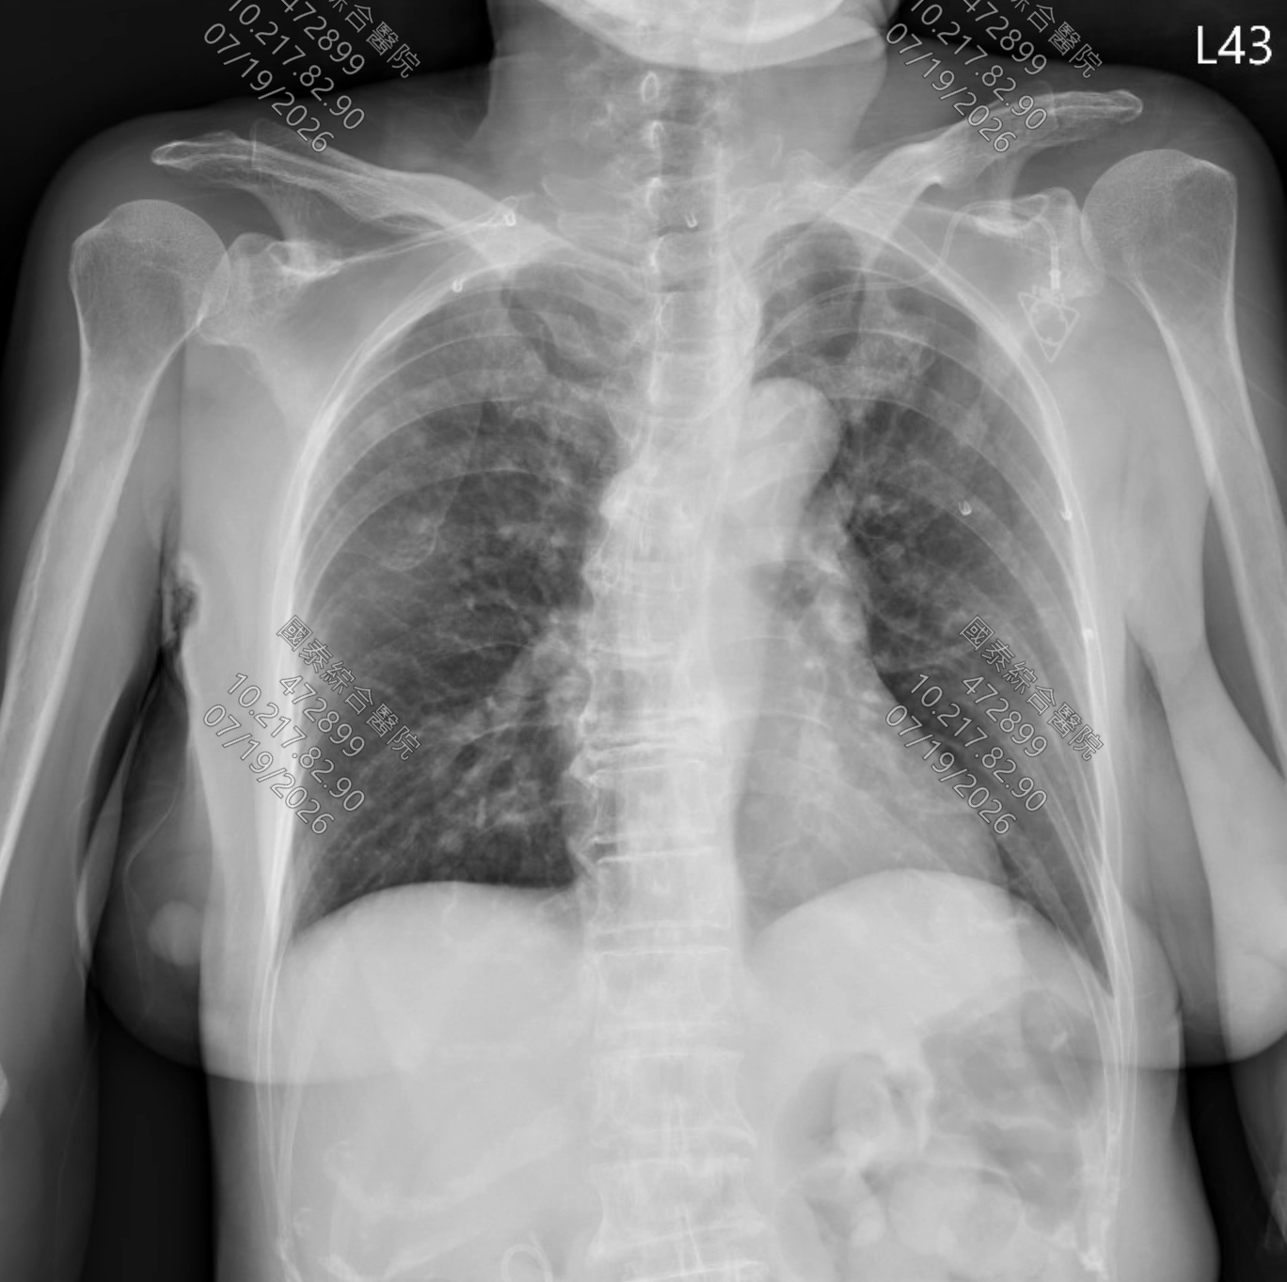
06/12

Slide 5
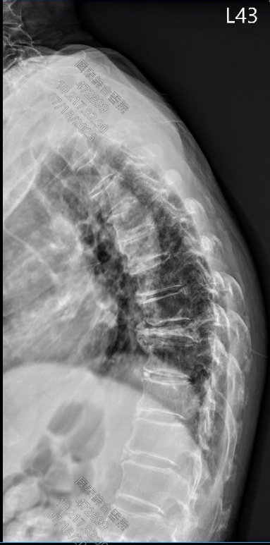
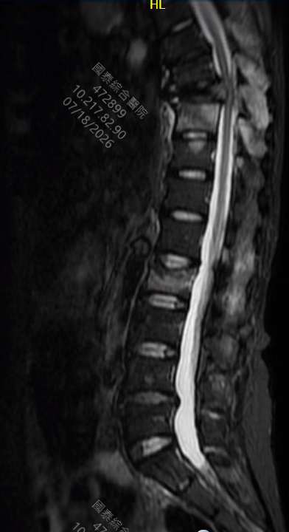
06/13

Slide 6
Timeline
Date | Clinical Course & Interventions
06/23 | Hemovac removed.
 | Initial PM&R consultation: confirmed incomplete spinal cord injury (NLI: T8, AIS D) with neurogenic paraparesis and sensory deficits. Bedside rehab initiated.
06/24 | Foley catheter successfully removed.
06/26 | Transferred to PM&R ward for prehabilitation.
06/29 | Surgical wound healed and all staples removed.
 | Central venous catheter removed following completion of Cerebrolysin course.

Slide 7
Timeline
Date | Clinical Course & Interventions
06/29 | Left neck and headache
 | => Clonazepam given for myofascial pain => C-spine X-ray spurs
07/08 | New-onset left peripheral facial palsy, tongue deviation to the left, drowsiness, and poor mental status.
 | Brain CT: multiple metastatic skull lesions, left cerebellar lesion with associated vasogenic edema.
 | Transferred back to GYN ward for further oncological management.

Slide 8
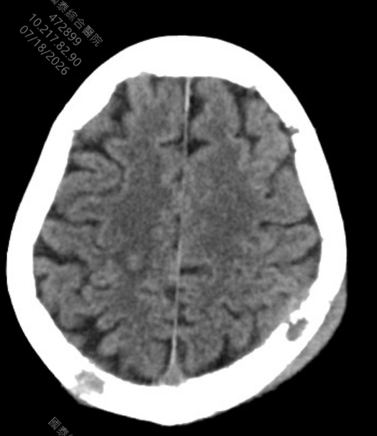
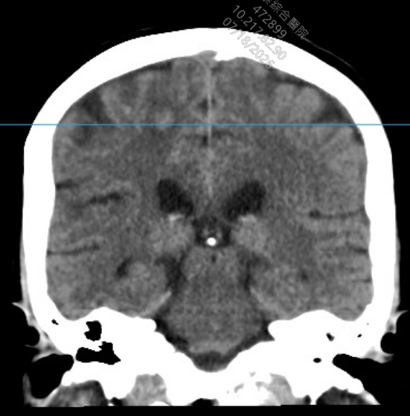
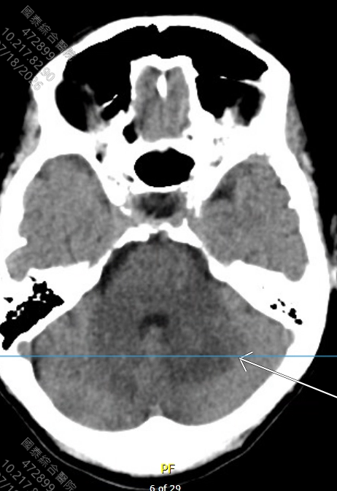
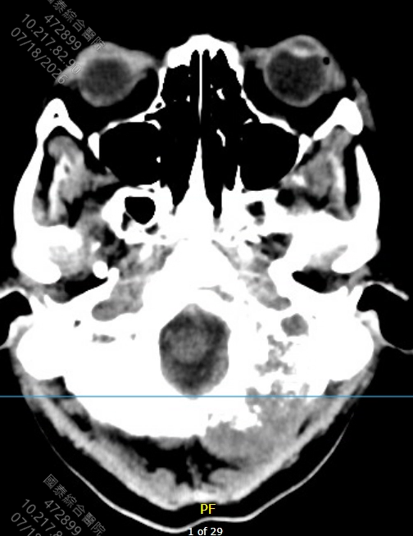
07/07 Brain CT

Slide 9
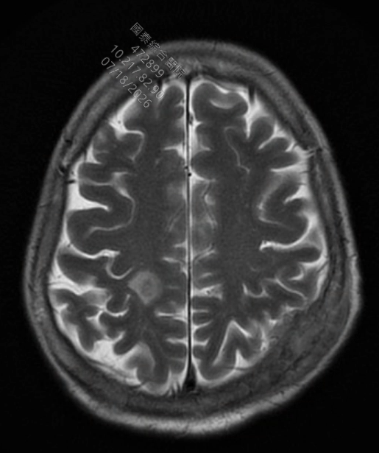
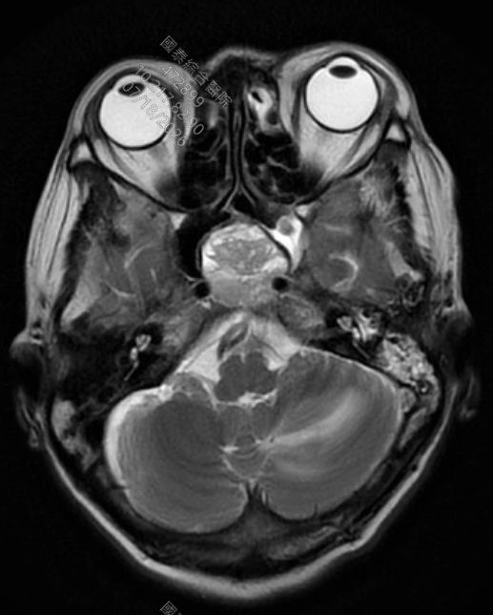
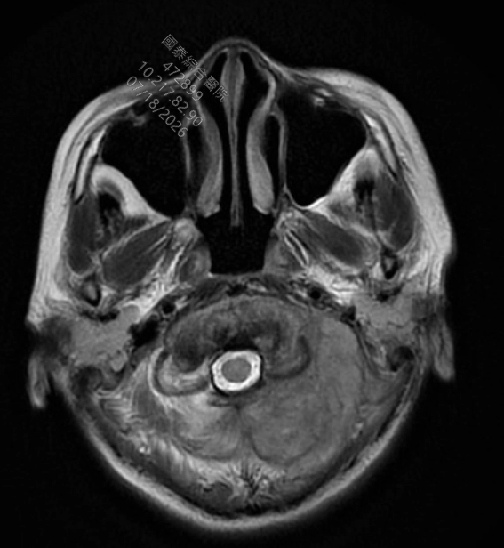
07/09 Brain MRI

Slide 10
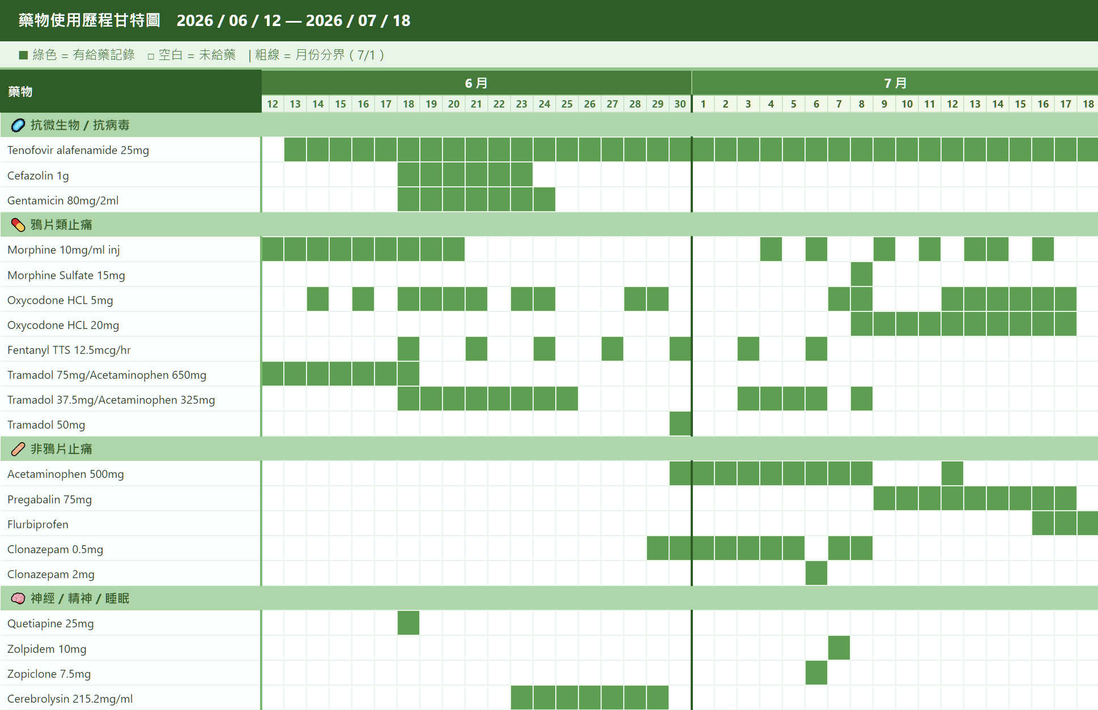

Slide 11
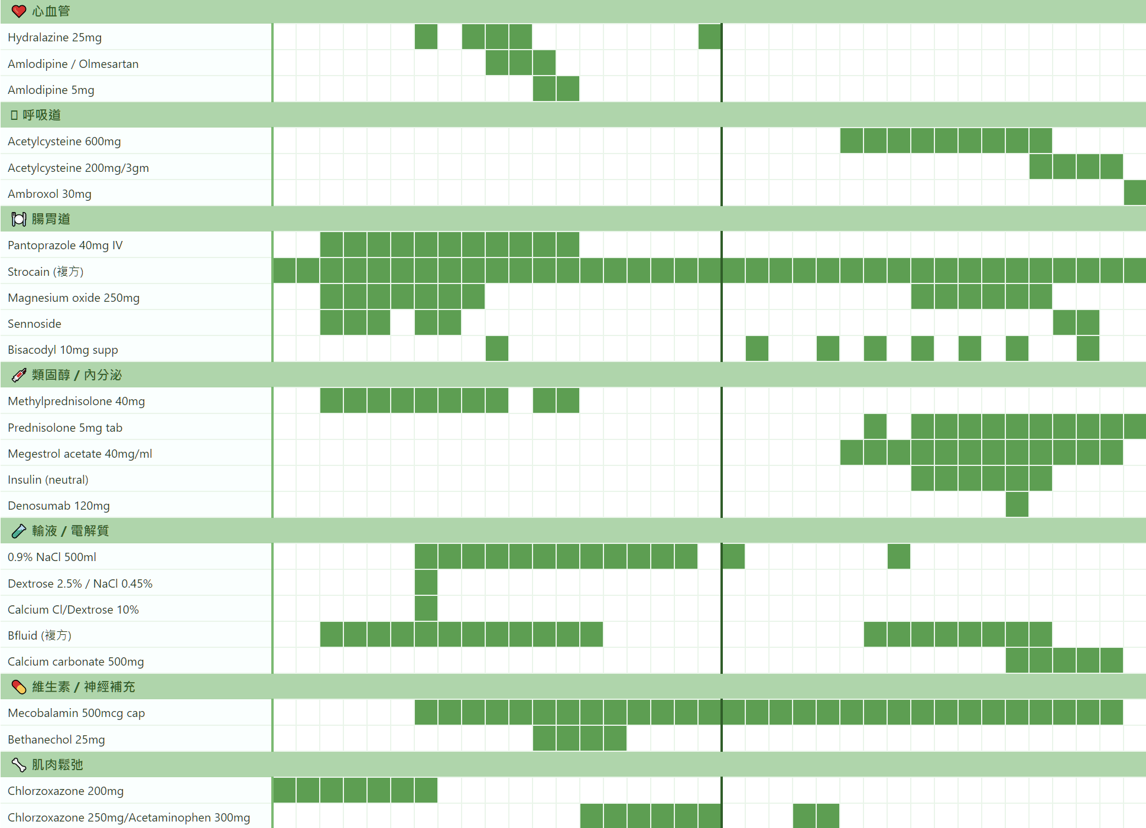

Slide 12
cerebrolysin

Slide 13
Diagnosis
# Ovarian cancer, endometrioid carcinoma, stage IVB, originated from endometriosis in retroperitoneum with iliac lymph node, pelvic adhesion, thoracic/lumbar spine, lung, brain metastasis
- status post retroperitoneal tumor biopsy (by general surgeon), right pelvic lymph node dissection and pelvic adhesiolysis on 2023/10/19
- status post chemotherapy with Paclitaxel ＋ Carboplatin ＋ Avastin (Q3W) 2023/10/25-2024/04/17, 9 cycles
- status post target therapy with Avastin 2024/05/11~2025/04/01, 15 cycles
- status post radiation therapy, 2025/04/15~2025/05/27
- status post immunotherapy of pembrolizumab, 2025/04/02~2025/07/19, 6 cycles
- status post chemotherapy with weekly Paclitaxel + Carboplatin + Bevacizumab since 2025/08/09, last cycle 6-3(Paclitaxel + Carboplatin ) on 2026/02/09
- with local recurrence and distant metastasis (liver, lung, bone)
- status post port-A indwelling on 2026/05/14
- status post chemotherapy with lipodox ＋ carboplatin ＋ Avastin since 2026/05/14, last cycle 2－0 on 2026/05/30

Slide 14
Diagnosis
#. T9, L2 pathological fracture, suspected ovarian cancer metastasis, s/p T9 tumor excision, T7-11 laminectomy, T7-8, T10-11 posterior fusion with Postero-lateral bone fusion, and L2 kyphoplasty (2026/06/17), with neurological deficits of bilateral lower limb weakness and numbness, NLI = T8, AIS D

Slide 15
Metastatic Spinal Cord Compression (MSCC)
約 60% 的次發性腫瘤轉移（Secondary體系）會侵犯脊椎骨骼。
主因：脊椎具有極豐富的血管供應 (Large Vascular Supply) 與淋巴引流 (Lymphatic Drainage)。
最常見癌別：肺癌、乳癌、攝護腺癌，三者合占脊椎轉移病例的 60% 以上；約 7% 的病例原發灶未知 (Unknown Primary)。
初次表現：約 20% 的患者首發症狀即為 MSCC（常見於肺癌、多發性骨髓瘤及非霍奇金氏淋巴瘤），此類患者高度需要組織病理確診以規劃全身性治療。
解剖分布：最具臨床神經壓迫的病變最常發生於胸椎 (Thoracic Tract)。
病理併發症：椎體破壞導致機械性不穩定，或腫瘤直接壓迫脊髓/神經根，引發癱瘓 (Paralysis)、感覺缺失及大小便功能障礙。隨著癌症患者生存期延長，MSCC 的發生率逐年上升。
Multidisciplinary Approach to Patients With Metastatic Spinal Cord Compression: A Diagnostic Therapeutic Algorithm to Improve the Neurological Outcome. Frontiers in Oncology. 2022. Rispoli R, Reverberi C, Targato G, et al.

Slide 16
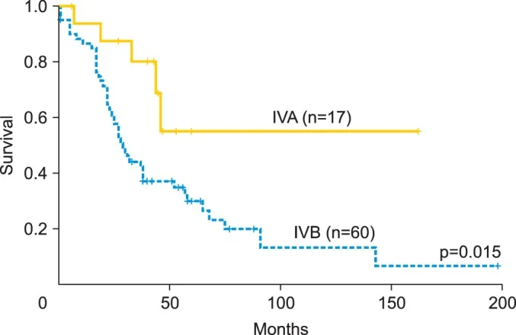
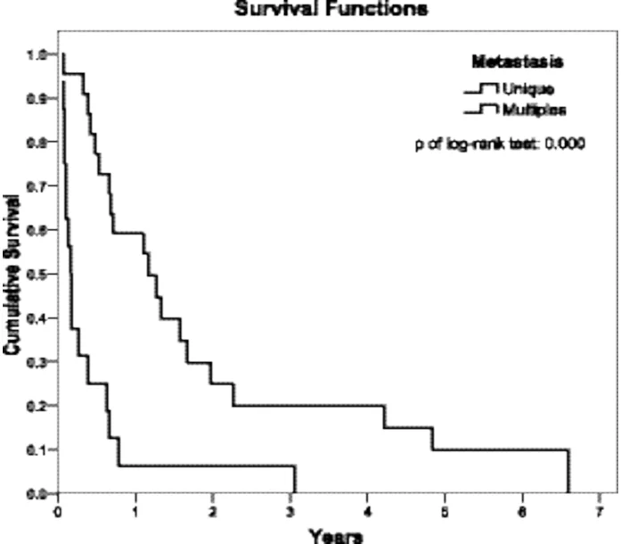
Prognosis
Improvements to the FIGO staging for ovarian cancer: reconsideration of lymphatic spread and intraoperative tumor rupture. Journal of Gynecologic Oncology 24(4):352. 2013.
Stage IVB endometrial cancer: clinical course and survival of patients with single and multiple metastases. European Journal of Gynaecological Oncology 36(5):529-532. 2015.

Slide 17
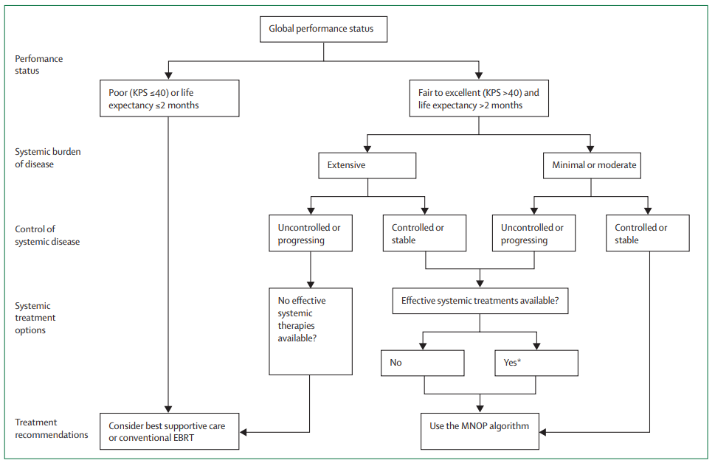
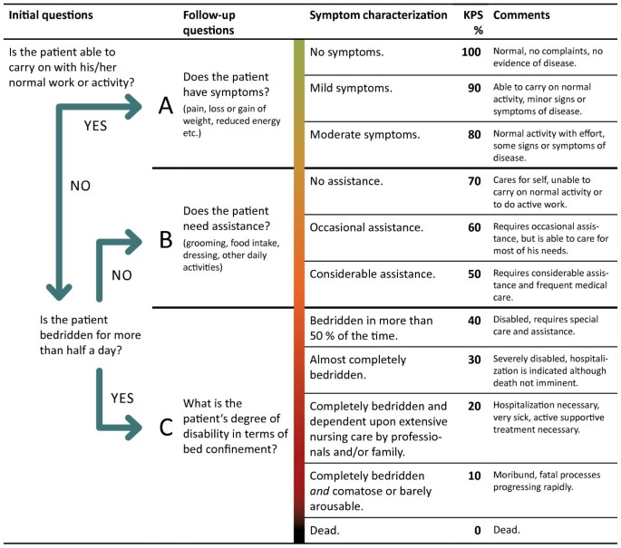
General Care

Slide 18
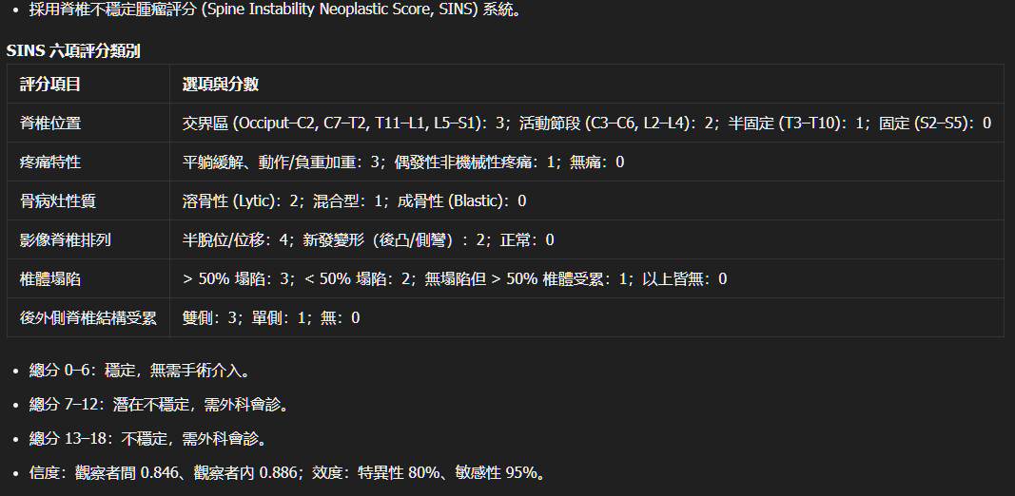
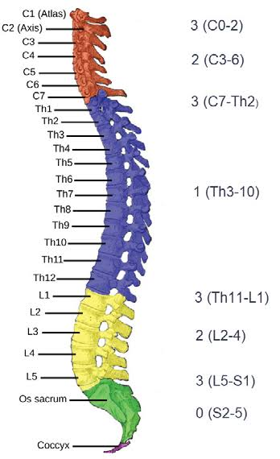
General Care
An Integrated Multidisciplinary Algorithm for the Management of Spinal Metastases: An International Spine Oncology Consortium Report. The Lancet. Oncology. 2017. Spratt DE, Beeler WH, de Moraes FY, et al.

Slide 19
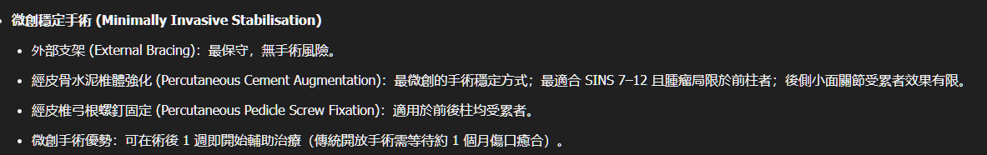
Surgical Options
An Integrated Multidisciplinary Algorithm for the Management of Spinal Metastases: An International Spine Oncology Consortium Report. The Lancet. Oncology. 2017. Spratt DE, Beeler WH, de Moraes FY, et al.

Slide 20
RT
已知癌症病史者：不需等待新的病理報告，應直接根據影像與臨床表現啟動放療。
初次表現即為 MSCC 且預後極危急者：為挽救神經功能，可採取「先放療、同步或隨後尋找原發灶/切片」的策略。
既有手術患者，放射治療的啟動不可過早，必須等待手術傷口達到初步的癒合；但亦不可過遲，以免殘存的硬膜外腫瘤組織快速復發，再次壓迫脊髓。臨床實務上，若傷口無特殊併發症，多於術後 14 至 21 天內開始放療。
Assessment and Management of Patients With Metastatic Spinal Cord Compression: A Multidisciplinary Review. Journal of Clinical Oncology : Official Journal of the American Society of Clinical Oncology. 2019. Lawton AJ, Lee KA, Cheville AL, et al.Review

Slide 21
Steroid therapy
過去曾有研究支持超高劑量類固醇（96 mg IV），但 2015 年 Cochrane 回顧指出其伴隨極高的嚴重副作用風險（如胃穿孔、精神病、感染致死）。
目前臨床專家多建議初次靜脈給予 Dexamethasone 10 mg，隨後每 6 小時給予 4–6 mg（靜脈或口服），並於放射治療結束後在 2 週內逐漸減量。
Assessment and Management of Patients With Metastatic Spinal Cord Compression: A Multidisciplinary Review.Journal of Clinical Oncology : Official Journal of the American Society of Clinical Oncology. 2019. Lawton AJ, Lee KA, Cheville AL, et al.
Metastatic Spinal Cord Compression: Unraveling the Diagnostic and Therapeutic Challenges.Anticancer Research. 2018. Boussios S, Cooke D, Hayward C, et al.

Slide 22
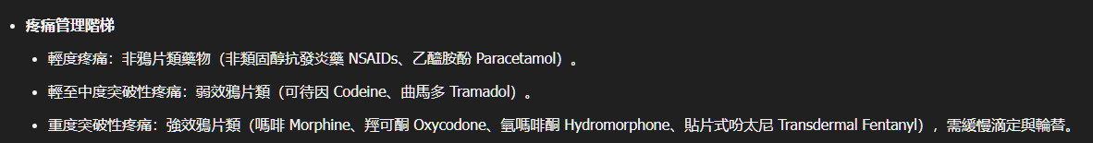
Pain Control
Dexamethasone 可兼治神經痛與骨轉移發炎痛。
抗癲癇藥（Gabapentin, Pregabalin）或三環抗憂鬱劑（Amitriptyline, Nortriptyline）可用於神經路徑受損引起的燒灼痛。
雙磷酸鹽（如 Zoledronic acid）對骨轉移疼痛有顯著幫忙，通常在 4 週內達到最大效果。
An Integrated Multidisciplinary Algorithm for the Management of Spinal Metastases: An International Spine Oncology Consortium Report. The Lancet. Oncology. 2017. Spratt DE, Beeler WH, de Moraes FY, et al.

Slide 23
Antiresorptive therapy
Bone-modifying agents are generally recommended for patients with expected survival ≥3 months.
Patients with symptomatic bone metastases or recent SREs may still benefit from ongoing bone protection even with poor performance status.
If bone-modifying agent not yet started: likely defer initiation unless specific indication (e.g., hypercalcemia)
If already on denosumab: do not abruptly stop—either continue or implement bisphosphonate transition
If already on bisphosphonate: may discontinue if transitioning to comfort-focused care.
An Integrated Multidisciplinary Algorithm for the Management of Spinal Metastases: An International Spine Oncology Consortium Report. The Lancet. Oncology. 2017. Spratt DE, Beeler WH, de Moraes FY, et al.
Management of Bone Health in Solid Tumours: From Bisphosphonates to a Monoclonal Antibody. Cancer Treatment Reviews. 2019. von Moos R, Costa L, Gonzalez-Suarez E, et al.

Slide 24
Antiresorptive therapy
First-line options (both are acceptable):
Denosumab 120 mg subcutaneously every 4 weeks
Zoledronic acid 4 mg intravenously every 3-4 weeks
An Integrated Multidisciplinary Algorithm for the Management of Spinal Metastases: An International Spine Oncology Consortium Report. The Lancet. Oncology. 2017. Spratt DE, Beeler WH, de Moraes FY, et al.
Management of Bone Health in Solid Tumours: From Bisphosphonates to a Monoclonal Antibody. Cancer Treatment Reviews. 2019. von Moos R, Costa L, Gonzalez-Suarez E, et al.

Slide 25
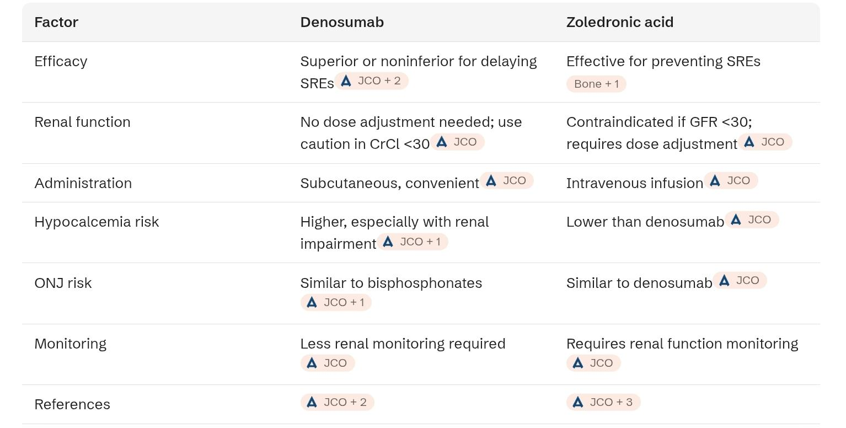
Antiresorptive therapy
An Integrated Multidisciplinary Algorithm for the Management of Spinal Metastases: An International Spine Oncology Consortium Report. The Lancet. Oncology. 2017. Spratt DE, Beeler WH, de Moraes FY, et al.
Management of Bone Health in Solid Tumours: From Bisphosphonates to a Monoclonal Antibody. Cancer Treatment Reviews. 2019. von Moos R, Costa L, Gonzalez-Suarez E, et al.

Slide 26
Antiresorptive therapy
Duration of Therapy
For bone metastases: Continue indefinitely as long as patient has bone metastases and is receiving active cancer treatment.
An Integrated Multidisciplinary Algorithm for the Management of Spinal Metastases: An International Spine Oncology Consortium Report. The Lancet. Oncology. 2017. Spratt DE, Beeler WH, de Moraes FY, et al.
Management of Bone Health in Solid Tumours: From Bisphosphonates to a Monoclonal Antibody. Cancer Treatment Reviews. 2019. von Moos R, Costa L, Gonzalez-Suarez E, et al.

Slide 27
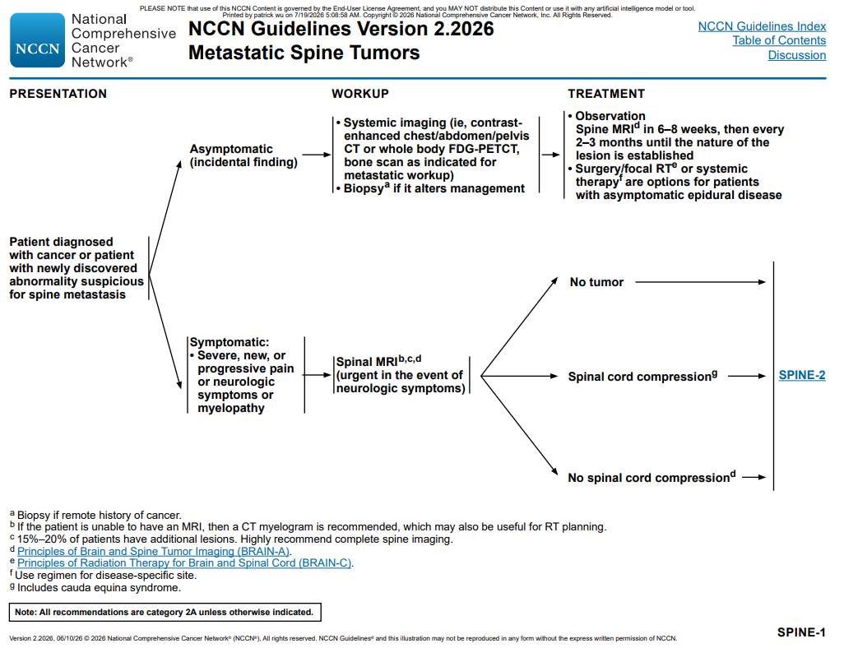
Baseline Imaging
Multidisciplinary Approach to Patients With Metastatic Spinal Cord Compression: A Diagnostic Therapeutic Algorithm to Improve the Neurological Outcome. Frontiers in Oncology. 2022. Rispoli R, Reverberi C, Targato G, et al.
NCCN Guideline, SPINE-1

Slide 28
Nutrition
115/06/26 體重：49.70 kg (-4.1)
追蹤內容說明：訂院伙特A餐，前幾天使用藥物後嘔吐，近2-3天因擔心嘔吐，盤餐僅吃1-2口，表示少量進食無不適，但食慾差。(Bfluid 6/25 已暫停)
進食量達需求量：<25% 曲線圖
具體改善建議、方法與目標：
其他：1.鼓勵少量多餐，給予餐間點心建議。 2.給予濃縮營養品(倍速益.補體素康健1.5)，指導補充方式。 3.續追蹤。
營養監測項目執行狀況：
1. 熱量攝取量：>1125大卡，仍需加強
營養問題改善狀況：
1. 熱量攝取不足，仍需加強

Slide 29
Nutrition
115/06/29 體重：53.80 kg (+0.0)
追蹤內容說明：食慾進步許多 院伙一半+自備食物蛋糕麵食等
進食量達需求量：75－100% 曲線圖
具體改善建議、方法與目標：
其他：均衡份量
營養監測項目執行狀況：
1. 熱量攝取量：>1125大卡，大部分已達成
營養問題改善狀況：
1. 熱量攝取不足，大部分已改善

Slide 30
Nutrition
115/07/03 體重：53.80 kg (+0.0)
追蹤內容說明：食量較不穩定 但都可外買 沒有喝營養品(覺得食物還吃不完先吃食物不要浪費) 詢問若喝牛奶或奶粉 是否要買去乳糖或銀髮奶粉或全脂低脂
進食量達需求量：75－100% 曲線圖
具體改善建議、方法與目標：
其他：提醒吃少時要喝營養品
營養監測項目執行狀況：
1. 熱量攝取量：>1125大卡，大部分已達成
營養問題改善狀況：
1. 熱量攝取不足，大部分已改善

Slide 31
Nutrition Suggestions
For bedridden cancer patients undergoing chemotherapy, recommended energy intake is 20-25 kcal/kg/day with protein intake of 1.5-2.0 g/kg/day.
Nutritional therapy should be initiated when daily intake falls below 60% of estimated energy expenditure for >10 days or with >5% recent weight loss.
若 3–5 天內口服無法滿足 60% 的需求，應果斷升級介入。
短期斷食 (STF)：化療前 48–140 小時及化療後 5–56 小時進行短期斷食，患者耐受性佳且安全，可能具備減輕治療副作用並改善生活品質 (QoL) 的潛力。
Summary of Evidence on Nutritional Management for Patients Undergoing Chemotherapy. Cancer Medicine. 2024. Dan X, He YL, Tian YL, Chen TL, Yu JY

Slide 32
EN vs. PN
管餵腸道營養 (EN)：優於腸外營養，能保護腸道屏障、支持免疫並利於血糖控制。適應症包括：高營養風險、無法口服進食、口服/ONS 無法滿足需求的患者（如口服攝入小於所需量的三分之二，或化療後持續腸炎 >7 天）。
EN 餵食管路與技術選擇：優先推薦鼻胃管 (Nasogastric tube)，並建議使用小管徑餵食管。
PN 絕對適應症：嚴重黏膜炎 (Severe mucositis)、無法控制的嘔吐、機械性腸阻塞、嚴重吸收不良、持續性腹瀉或症狀性腸移植排斥反應。

Slide 33
Oral Nutritional Supplements (ONS) - High Priority
High-protein, omega-3 PUFA-enriched ONS should be prioritized over standard formulations:
Specific product recommendations:
亞培安素Plus Advance - 1.5 kcal/mL, high protein (18g/237mL), enriched with omega-3 fatty acids and HMB (β-hydroxy-β-methylbutyrate) for muscle preservation
Supportan（倍速/加力康）- specifically designed for cancer patients, contains omega-3 fatty acids (EPA/DHA), high protein, and immune-modulating nutrients
亞培倍力素（ProSure） - enriched with EPA (omega-3), high protein, designed for cancer cachexia
倍速益 (Boost) 1.5 or 補體素康健 1.5 - acceptable alternatives if omega-3 enriched versions unavailable
Dosing protocol: 200-400 mL between meals, 3 times daily (the "3+3 model": 3 main meals + 3 ONS servings)

Slide 34
Adjunct
皮質類固醇 (Corticosteroids)：晚期癌症患者出現食慾不振時，可考慮短期使用 (1–3 週) 以刺激食慾（推薦強度 I/B），但必須嚴密監測肌肉萎縮、胰島素抗性及感染等副作用。
孕激素 (Progestogens)：可用於增加晚期厭食症患者的食慾（I/B），但須注意血栓栓塞 (Thromboembolism) 的嚴重副作用。
胃腸動力藥 (Prokinetic drugs)：針對早飽 (Early satiety) 患者，在排除便秘後可考慮使用。但需警惕 Metoclopramide 引起的中樞神經系統副作用（如不可逆的遲發性運動障礙），以及 Domperidone（特別是靜脈注射）引發的心律中斷（Q-T 間期延長、心室頻脈）。

Slide 35
Vitamins
Vitamin D
Dose: 2000-4000 IU daily (or 50,000 IU weekly if severely deficient)
Rationale: Prevents osteoporosis in setting of bone metastases, improves physical performance in SCI patients
Product: Cholecalciferol 1000 IU capsules, 2-4 caps daily
Vitamin B Complex (especially B12)
Dose: B12 1000 mcg daily (oral or IM weekly if absorption impaired)
Rationale: Neurological prophylaxis in chronic SCI, supports nerve regeneration
Product: Methylcobalamin 1000 mcg sublingual or IM injection
Note: Patient already receiving Mecobalamin 500 mcg TID - increase to 1000 mcg TID or add B-complex
Bioactive Role of Vitamins as a Key Modulator of Oxidative Stress, Cellular Damage and Comorbidities Associated With Spinal Cord Injury (SCI). Nutritional Neuroscience. 2023. Pedroza-García KA, Careaga-Cárdenas G, Díaz-Galindo C, et al.

Slide 36
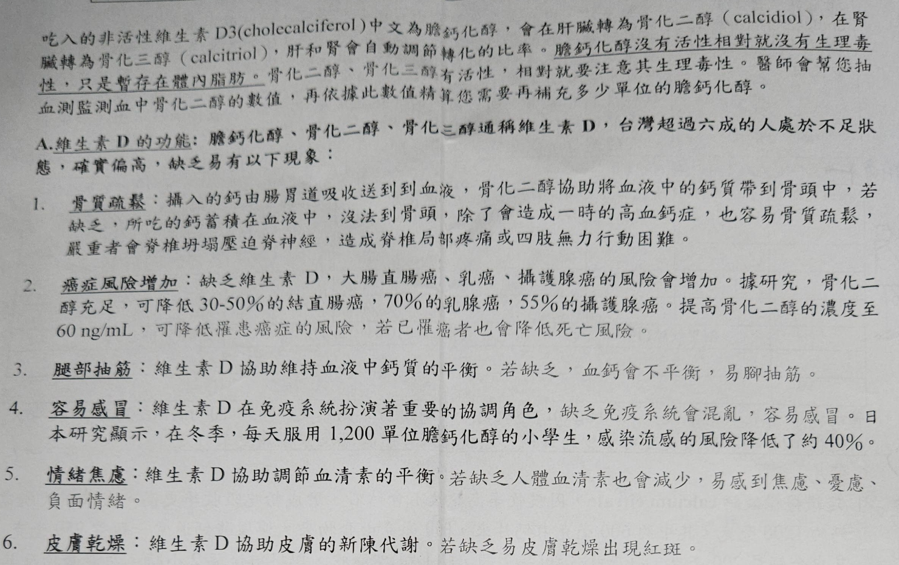
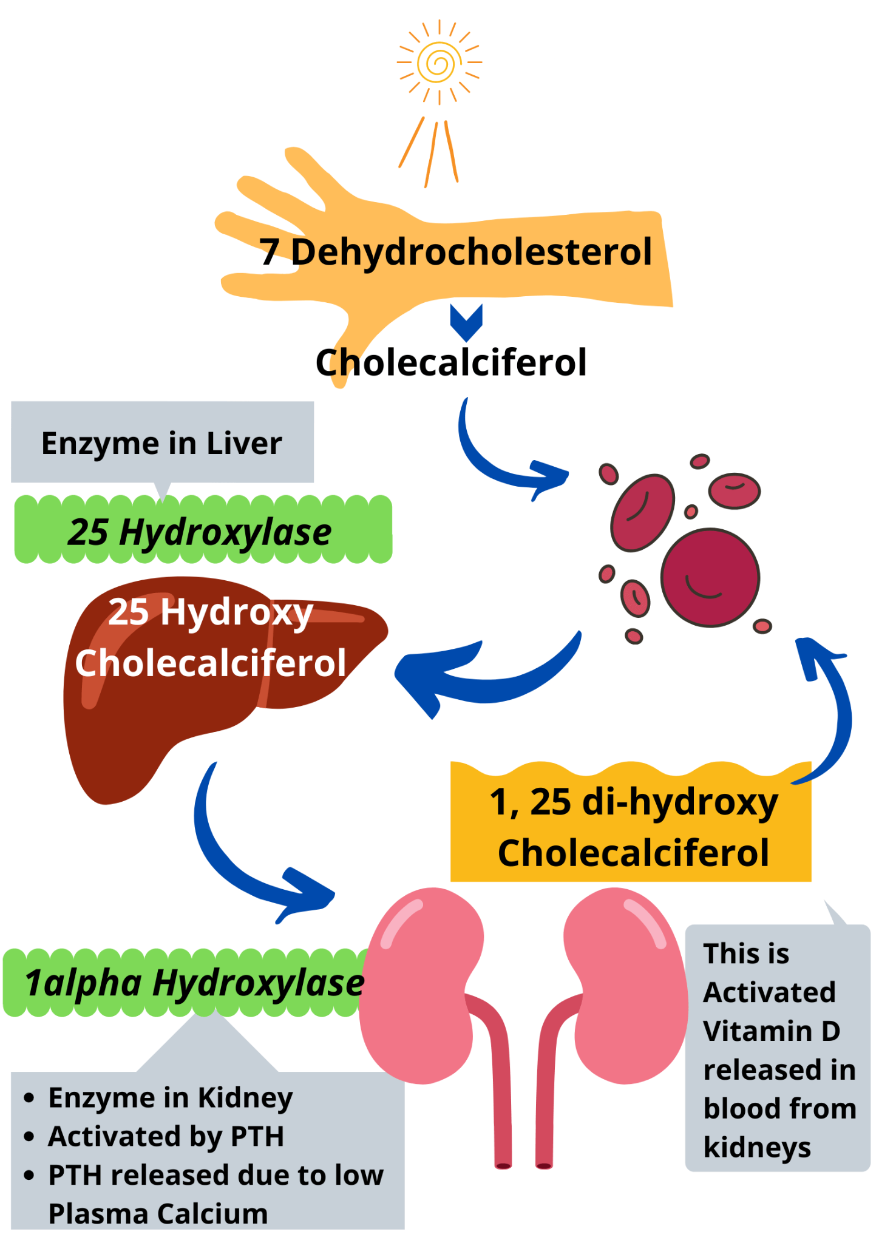
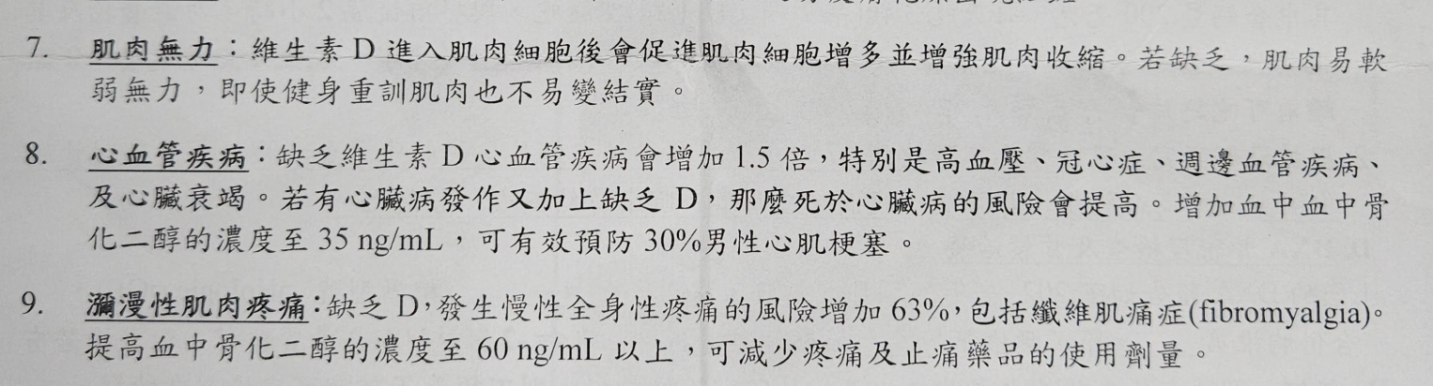
Vitamin D
Calcidiol
Calcitriol
台北榮總復健醫學部李思慧醫師門診衛教單張

Slide 37
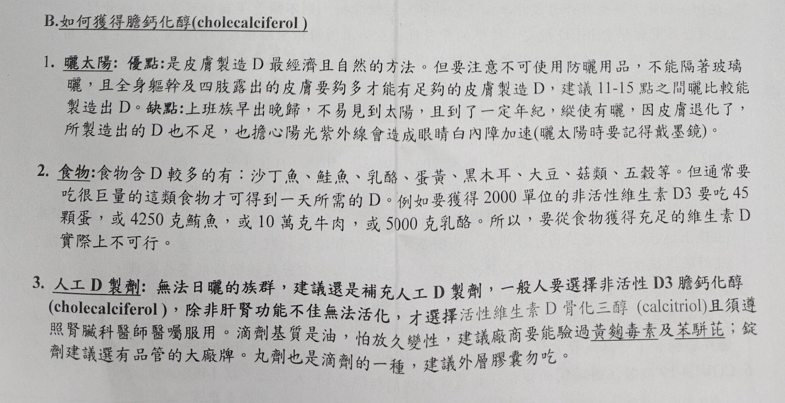
Vitamin D
台北榮總復健醫學部李思慧醫師門診衛教單張

Slide 38
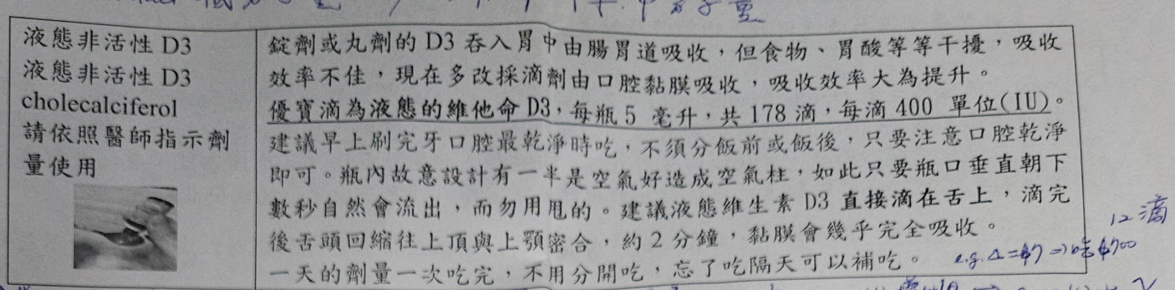
Vitamin D
台北榮總復健醫學部李思慧醫師門診衛教單張

Slide 39
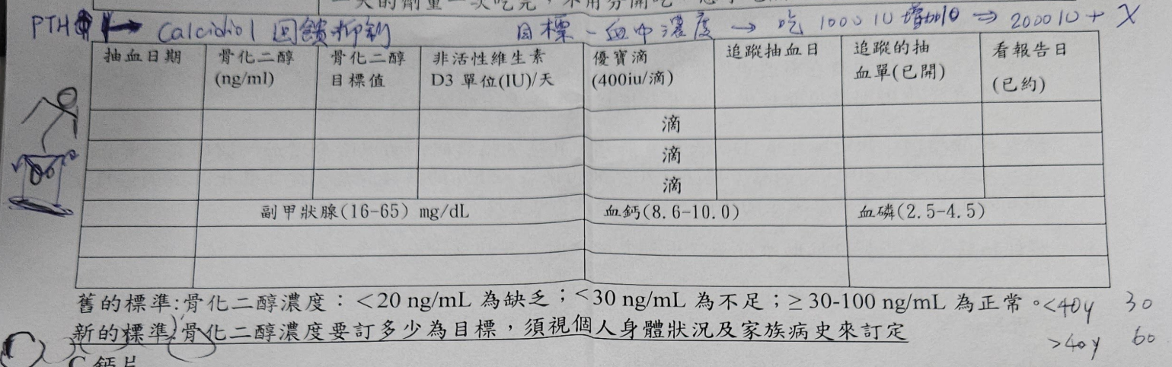
Vitamin D
台北榮總復健醫學部李思慧醫師門診衛教單張

Slide 40
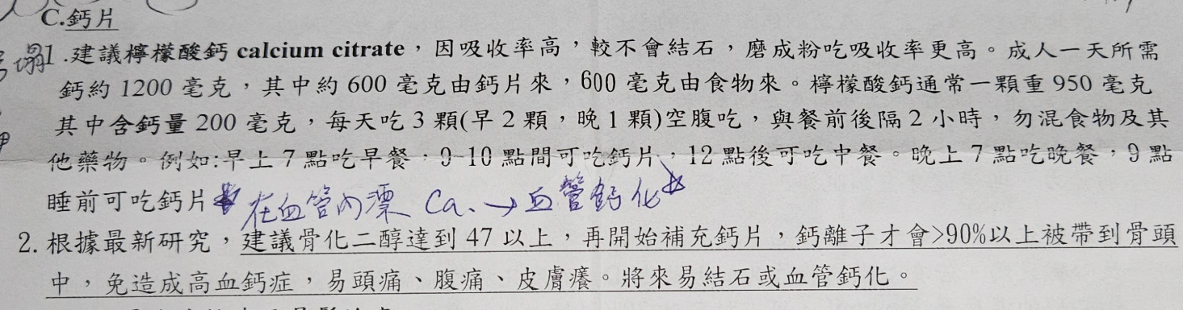
Vitamin D
台北榮總復健醫學部李思慧醫師門診衛教單張

Slide 41
Bfluid
適應症: 經口攝取不足、輕度的低蛋白血症、輕度的營養障礙、手術前後等狀態時的氨基酸、電解質、維生素B1及水分之營養補給。
主要包含四大成分：
氨基酸（Amino Acids）：15公克（不足每日需求）。提供蛋白質來源，修復組織、維持肌肉量，並改善輕度低蛋白血症。
葡萄糖（Glucose）：提供身體所需的基礎非蛋白質熱量。
電解質（Electrolytes）：包含鈉、鉀、鈣、鎂、鋅等離子，維持體內水分與電解質平衡。
維生素 B1（Thiamine）：特別添加維生素 B1，能預防在補充葡萄糖時引發嚴重的維尼克腦病變（Wernicke's Encephalopathy）。
禁忌症：肝性昏迷、重度腎臟病、充血性心衰竭及嚴重酸中毒患者禁用。
輸注速度：通常由周邊靜脈持續輸注，每 500 mL 的標準輸注時間至少需要 120 分鐘以上，過快可能引發心悸、血管痛或代謝負擔。

Slide 42
TPN
全靜脈營養 (若經口進食量持續 <60% 超過 3-5 天)
三合一 TPN 營養袋 (例如：Kabiven、Olimel、Nutriflex)，提供：
  熱量：25-30 kcal/kg/day = 1250-1500 kcal/day
  蛋白質：1.5-2.0 g/kg/day = 75-100 g/day
  脂質：優先選用 SMOF-based 劑型
  電解質、維生素、微量元素

Slide 43
SMOF-Lipid
SMOF Lipid (大豆油、中鏈三酸甘油酯、橄欖油、魚油乳劑)
適應症：當經口攝取或腸道營養不足，且患者需要補充熱量時使用。
劑量：0.7-1.5 g/kg/day（以此 50 kg 患者而言，約為每天 50-75 g）= 20% SMOF lipid 250-375 mL。
臨床效益：提供 omega-3 脂肪酸（具抗發炎作用），與純大豆油脂肪乳劑相比，能降低感染風險。
特別益處：考量到患者有惡病質（cancer cachexia）及發炎狀態，此劑型特別有益。

Slide 44
Summary
分期: 手術前後考慮 pathological fracture，考慮 Brain + C+A+P CT。
病情告知: 明確告知轉移 = 末期，IVB存活率約不到 2 個月。
手術如可選擇 MIS，術後 1-2 周內啟動放射治療。
疼痛: 精神若在 opiod 類藥物使用之下如果沒有很差，可使用。
營養: opioid 類藥物可配合 PN 與 Prokinetics 處理消化與營養問題。
類固醇使用: 繼續使用直到 RT 結束後於兩周內減量。

